Slide 1
DATA MODELLING AND WEIGHT PREDICTION OF FOETUS WITH REAL-TIME DATA ANALYSIS
BY –VARTIKA LAMBA (1802911057)
KRITIK BANSAL(1802911018)
ANUPAM KUSHWAHA(1802911008)

Slide 2
MOTIVATION
A new baby's gender, name, time of birth, and birth weight are nice information for a birth announcement, but birth weight is especially important for an obstetrician. A large size at delivery has long been associated with an increased risk of injuries to a newborn and its mom. So the better a doctor can predict birth weight, the easier the delivery may be.
The main of this project was always to make it of use to people who don’t have access to ultrasound facilities which also shows about (10-15)% error.
The reason why real-time data analysis is done in this project so that it can be deployed remotely to people by just taking very basic and simple information from the pregnant women.

Slide 3
INTRODUCTION
From the motivation, we know that ultrasound always shows about 10%-15% error in measuring the weight of a foetus hence determining the foetal growth. by taking a dataset having more than a lakh points was enough to train our prediction model and deploy it over real-time data using graphic user interface made by Tkinter.
This model takes basic information such as age of the mother, any complications, any previous pregnancy, how many weeks far is she with the pregnancy, her race, if smokes then how many cigarettes a day, how much is the weight gained during pregnancy, is she diabetic etc.
After applying the appropriate model and training and testing it over the pre-collected dataset, we get our Machine Learning deployment model ready to be used over the related information collected in real-time using a GUI and making predictions about the weight of a foetus.

Slide 4
FLOW PROCESS
Data Collection
Data Pre-processing & Exploration
Training Model
(Linear Regression)
Deployment of model over real-time data
Testing Model
Creating a GUI

Slide 5
DATA COLLECTION –
A dataset with about 1.3 lakh points was collected with 37 attributes.
DATA PRE-PROCESSING AND EXPLORATION –
This step helps us understand the target variable birth weight — its mean, standard deviation, minimum and maximum values, median etc. We also plot a histogram of the birth weight variable to understand its nature. We also compute the skew and kurtosis of the target variable.
Next, we identify the categorical values from the training dataset and print the qualitative and quantitative columns. At this point, we process the missing values and set them as ‘MISSING’. We also take the qualitative variables HISPMOM and HISPDAD and encode it.
Lastly, we use the Spearman’s rank correlation to find correlations between variables and take the most correlated features in Correlated_Feature list and use it for further modeling. Some of the most correlated features were the completed weeks of gestation, amount of weight gained by mother, age of mother, race of parents and number of prenatal visits.

Slide 6
TRAINING MODEL -
Next, we split 80% of the data to the training set while 20% of the data to test set using below code. The test_size variable is where we actually specify the proportion of the test set.
Here the “training” set is the data file used to create the machine learning model and the “test” set is the one where we use our model to predict the target variables. ATrain and ATest splits the correlated features while BTrain and BTest splits the Birth weight variable.
After splitting the data into training and testing sets, finally, the time is to train our algorithm. For that, we need to set the seed and use theta to calculate the predicted value and improve the model. One can also use the scikit learn Linear Regression library for this step.
TESTING MODEL –
Lastly, let's use the model to predict the birth weight target variable for each of the testing dataset using the regression model we fitted in Step 4 examined how well the model performed using error functions.

Slide 7
We took the Average RMSE and Standard Deviation to evaluate the linear model. The RMSE is the more popular metric and is typically used as the primary metric to interpret the model, along with standard deviation.
The Average RMSE came around 1.07 which I felt is decently good for this dataset. Also, the standard deviation was around 2.64 which could be improved by trimming features further. Although there is still some good enough error, these birth weight predictions might help aid the doctor in estimating size of baby during delivery more accurately.
CREATING A GUI PICKLING –
We used pickle library on this model that would be used to compute predictions for new data points. Since we are now done with pickling the file. Now we created a GUI using Tkinter that will be used to capture new data points. For creating the labels (features) we made different columns whose information was valid enough to take.
Deployment - After creating all the buttons that are mainly the features that will store the new data point values. To compute prediction using any model we need a data frame on which we have to make the prediction. Once a user enters a different set of values we then have to create a data frame of it. Now we will created a submit button. Once this button is clicked the above action of data frame creation is done. We will once again convert every value that is inputted by the user to numerics. We have entered the values for the features now when we click on submit to create the data frame and right after that we will click on the Predict button to check the prediction.

Slide 8
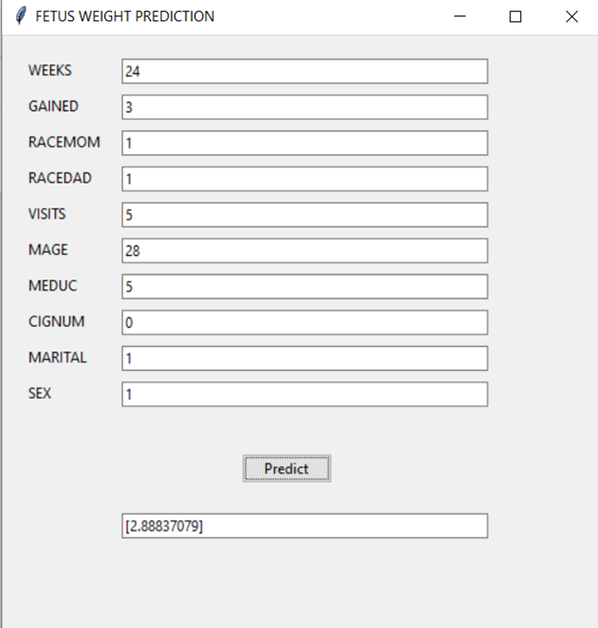
RESULT GUI

Slide 9
CONCLUSION
Birth weight acts as an indicator of sickness in newborn babies as well as complications in pregnancies. Birth weight is closely associated with infant mortality as well as various health outcomes later in life. Various studies show strong correlation between maternal health during pregnancy and the child's birth weight. Expectedly, the proposed model achieved a great accuracy. Hence we conclude that Machine learning techniques is definitely a boon for areas where healthcare is still a luxury that most people can’t get.

